Slide 1

Learn Ansible, all you need
Subscribe my YouTube Channel
“SimplyLearn”

Slide 2
Pre-requisite Knowledge: Required: Basic understanding of Linux/Windows OS

Slide 3
What is Ansible?
Ansible is an open source community project sponsored by Red Hat. It’s an automation tool that can be used across entire IT teams from systems and network administrators to developers and managers. Ansible is an agentless push based automation tool. Ansible uses YAML(Yet Another Markup Language) to write the automation codes.

Slide 4
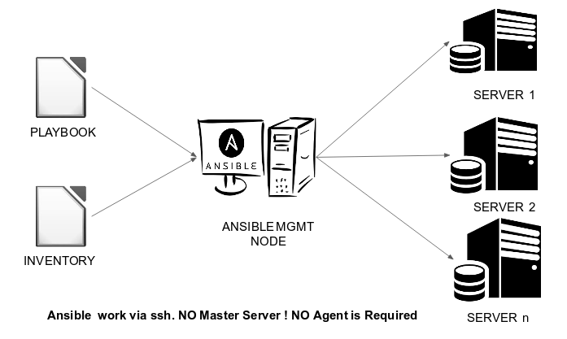

Slide 6
Thank you for watching…!!!
Please like this video and
Click the “Subscribe” button below

